Slide 1

Breast cancer fatality prediction
Multivariate Data Analysis
Group 1:Nasir Ali, Misato Hashiguchi, Matthew Hoyle, Grashma Nikhitha Pulimi, Ilse Super, Emma Biss

Slide 2

Introduction & Background
Our dataset contains synthetic data on breast cancer patients from the Netherlands Cancer Registry (NCR), which is based on statistical patterns found by NCR on real breast cancer patients.
The dataset included data related to the patient, tumor, and treatment. After cleaning the dataset, it included 12,266 observations and 23 variables. Both metric and non-metric variables are present in the dataset.
We conducted 1) Exploratory Factor Analysis to identify underlying dimensions and reduce the dimensionality, and 2) Logistic Regression to investigate which variables are significant predictors of the dependent variable.
The dependent variable analyzed in Logistic Regression was vit_stat. This binary outcome variable indicates the vital status of the patient five years after the incidence year. One indicates alive and zero indicates deceased.
Source: https://iknl.nl/en/ncr/synthetic-dataset

Slide 3

Management Proposal
Problem Statement:
Despite advancements in breast cancer research and treatment, optimizing patient outcomes remains challenging. The lack of clarity surrounding the complex interactions between tumor biology, treatment options, and patient demographics hinders the development of effective breast cancer management strategies.
Primary Research Questions:
What variables could be combined for data reduction?
Which factors/variables significantly influence the mortality of breast cancer patients?
Goal and Objective:
With this we want to identify the factors possible for data reduction, assess the relative importance of different variables in the prediction of patient survival.
Expected Outcomes:
By achieving these objectives, we anticipate uncovering some insights that could possibly inform us of evidence-based clinical outcomes based upon factors within the dataset that could predict patient survival which could inform treatment options.

Slide 4
Data examination: Attributes
We utilized 23 variables both metric and non-metric:
Incidence Year: Year of diagnosis.
Age at Diagnosis: Patient's age at diagnosis.
Vital Status: Patient's survival status after 5 years and interval since diagnosis and status.
Vital Status Interval: Days from incidence date until patient's survival status after 5 years.
Laterality of the Tumor: Side of the breast affected by the tumor.
Differentiation Grade: Tumor's differentiation level.
Hormone Receptor Status: Presence of estrogen and progesterone receptors in the tumor.
Nodes: Number of nodes investigated and number of positive nodes.
Tumor Stage: Categorization of tumor size and extent.
Her2 Protein Status: Presence of Her2 protein in the tumor.
Multifocality: Presence of multiple tumors in the same breast area.
Reconstruction and Dissection: Immediate reconstruction and axillary node dissection performed.
Tumor Morphology: Classification of tumor morphology.
Tumor Size: Pathological size of tumor.
Surgery Type: Type of surgical procedure undergone.
Treatment Modalities: Administration of chemotherapy, hormonal therapy, radiotherapy, and targeted therapy.

Slide 5
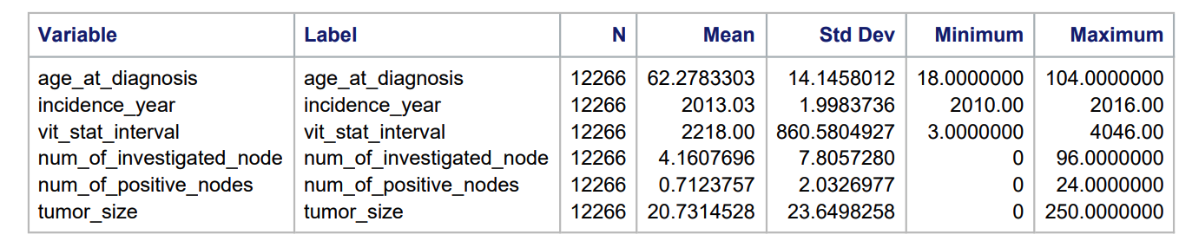
Data examination: Metric variables

Slide 6
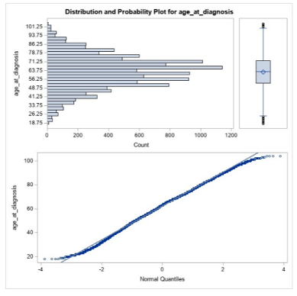
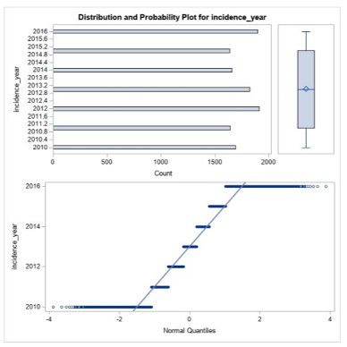
Data examination: metric variables

Slide 7
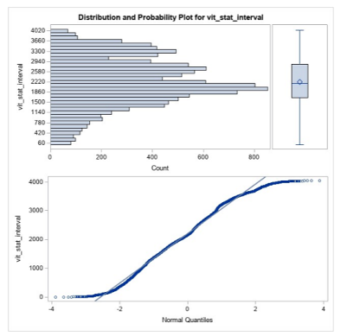
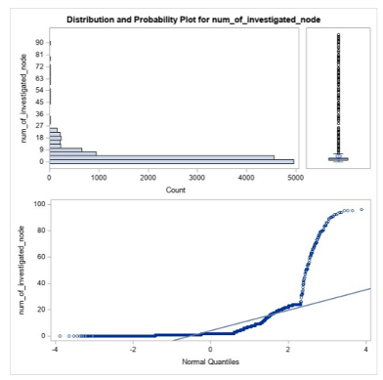
Data examination: metric variables

Slide 8
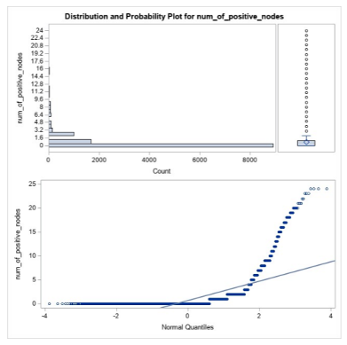
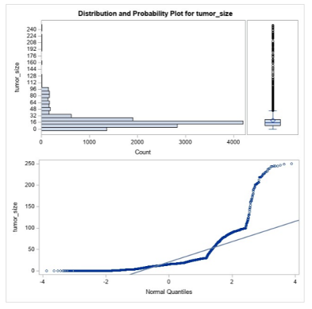
Data examination: metric variables

Slide 9
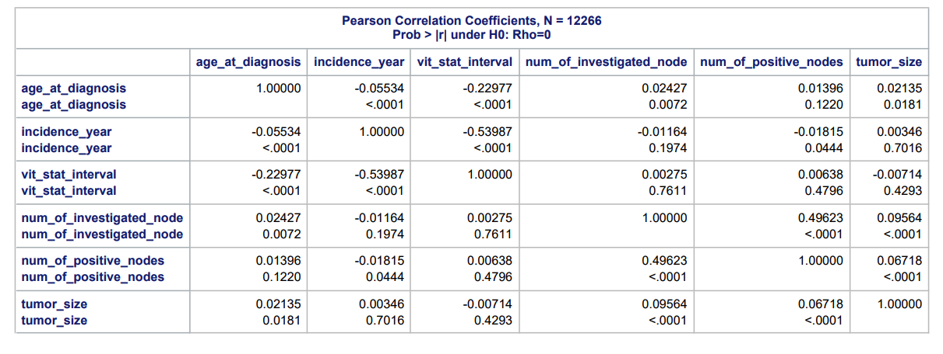
Data examination: correlation matrix

Slide 10
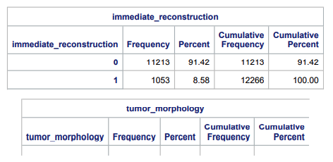
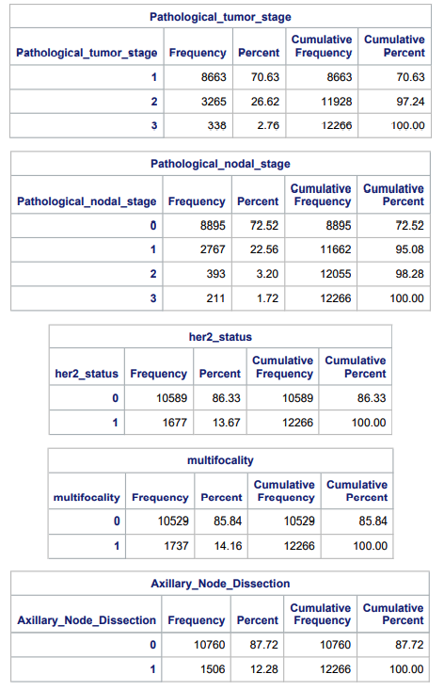
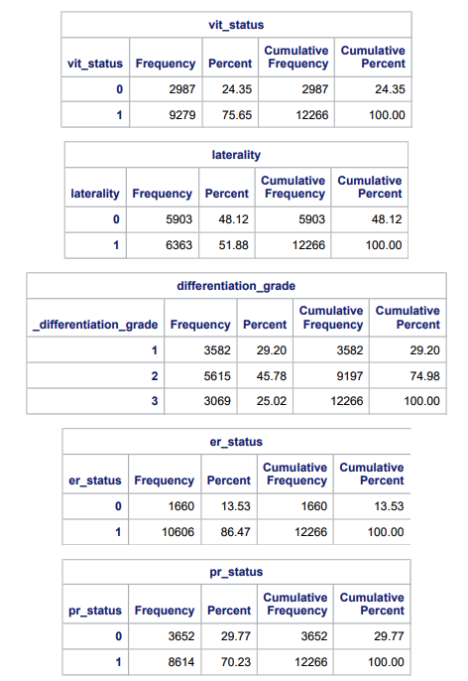
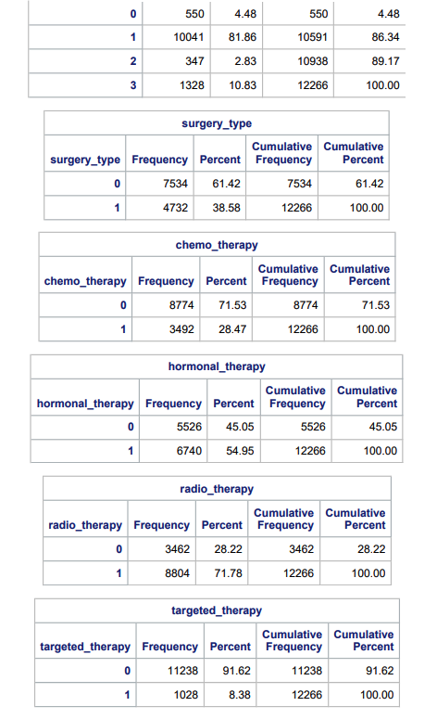
Data examination: non-metric variables

Slide 11
Factor analysis
We start our factor analysis with 6 variables, all metric.
Age at diagnosis, vital status interval, incidence year, number of investigated nodes, number of positive nodes, tumor size.
The goal is to reduce the number of variables through factor analysis

Slide 12
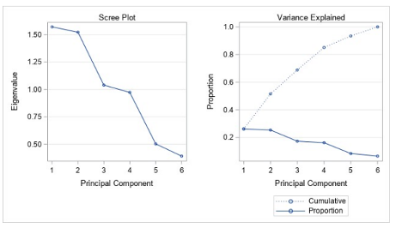
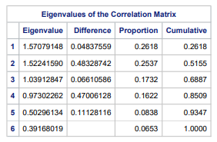

Factor analysis
The eigenvalues suggest that three factors may be sufficient to capture the majority of the variance in the data.
The Scree Plot and Variance Explained Plot support retaining three factors, as there is a clear elbow or drop in the eigenvalues after the second factor.
The Kaiser MSA after factor analysis including all variables is, however, lower than 0.5. Therefore, we delete the variable with the lowest MSA below 0.5. In our case, this is "Age at diagnosis".

Slide 13
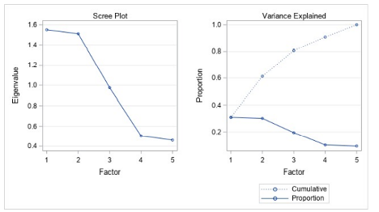
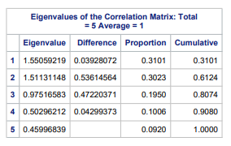

Factor analysis
The eigenvalues suggest that two factors may be sufficient to capture the majority of the variance in the data, as the eigenvalue drops below 1 at the third factor.
The Scree Plot and Variance Explained Plot support retaining three factors, as there is a clear elbow or drop in the eigenvalues after the second factor, and according to the scree plot you select the value after the drop.
After deletion of the variable, the MSA is above 0.5 for all variables, meaning we can do the factor analysis with these 5 variables.

Slide 14
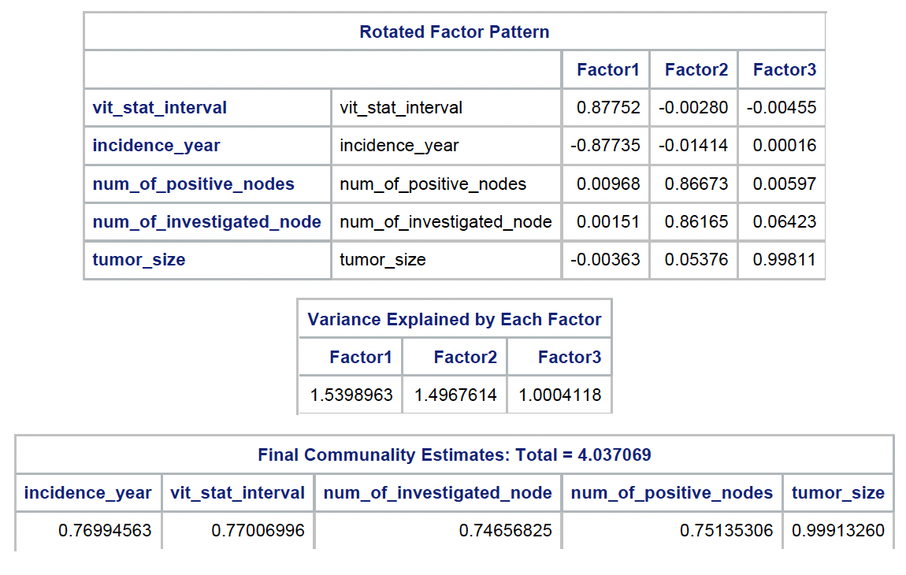
Factor analysis
After varimax rotations, these are the variables loading on the three factors:
"Vital status interval" and "Incidence year" load on factor 1
"Number of investigated nodes" and "Number of positive nodes" load on factor 2
"tumor size" loads on factor 3

Slide 15
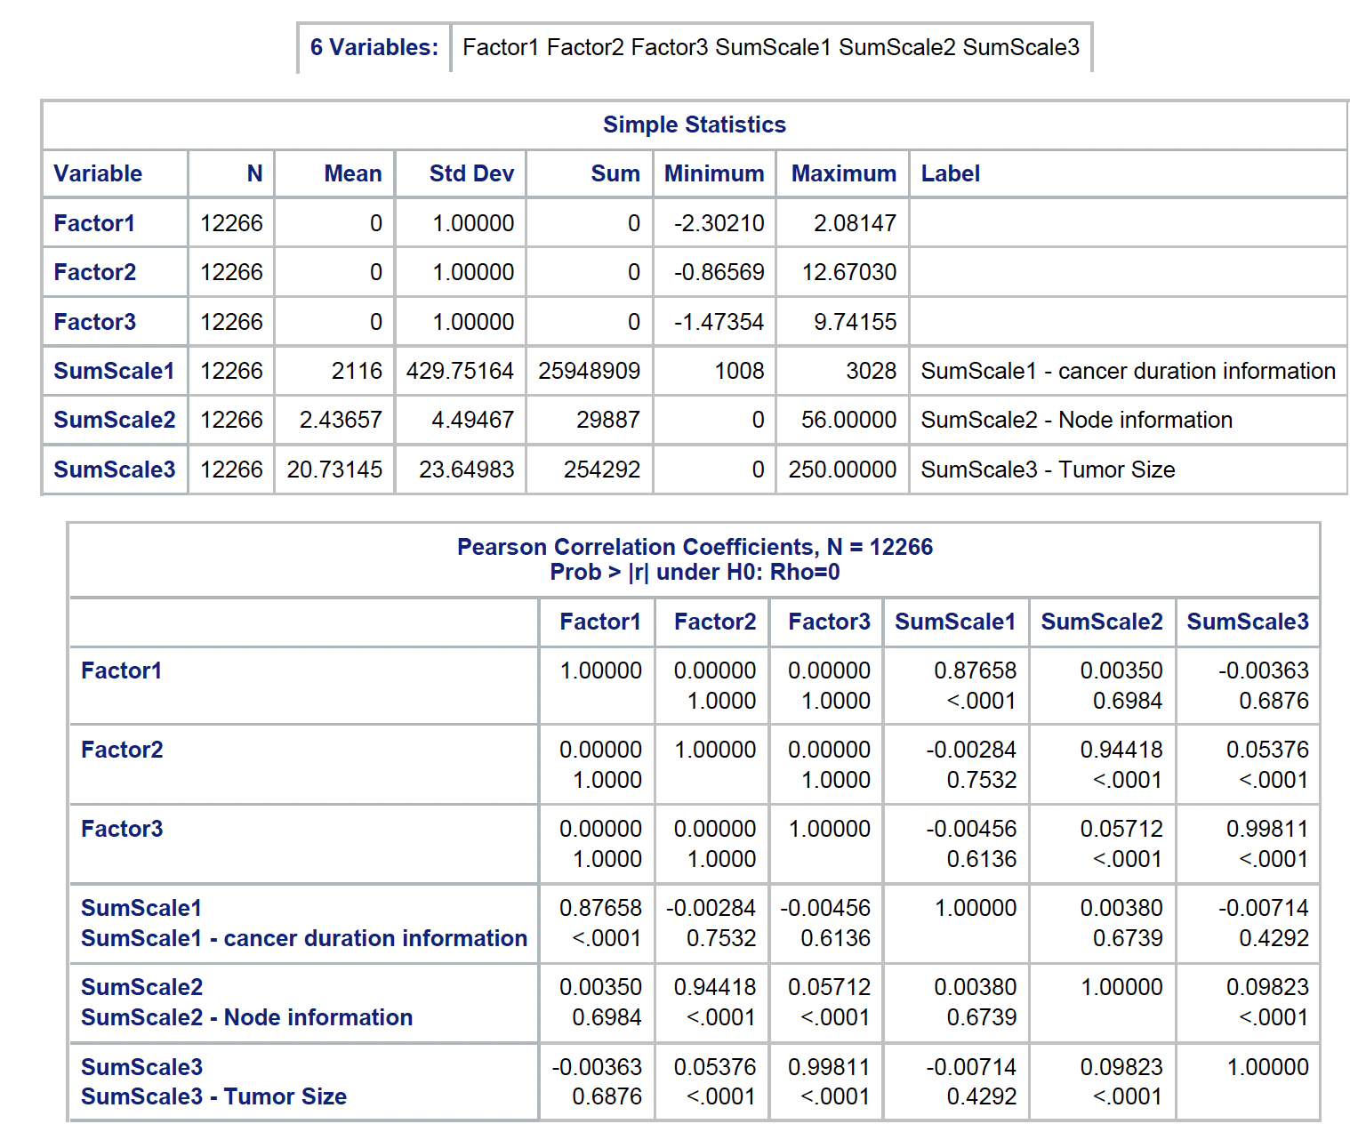
Factor analysis
We have created both factor scores and summated scores.
Summated scores are based on the values of the variables that load the factor, taking their average.
Factor scores are created taking all variables and their correlations into account, assuming no correlations between factor scores (as seen in correlation matrix).
In reality, there mostly is correlation between factors still, so we would recommend to go with summated scales if we were to advice management.

Slide 16
logistic regression: Assumptions
Requires the dependent variable to be binary.
Does not require any specific distributional form of the independent variables.
Assumes little to no multicollinearity among the predictors.
Requires a large sample size. (N=122,666 in our case.)
Notes:
Verification: Based on the correlation matrix, certain variables such as the number of positive nodes (num_of_positive_nodes) and the number of investigated nodes (num_of_investigated_node) show some level of correlation (0.50). While not excessively high, it’s essential to monitor these variables as potential sources of multicollinearity.
Outliers can have a disproportionately large effect on the estimate of regression coefficients.
The explanatory variables and the Logit of response variable have a linear relationship between them.

Slide 17
Logistic regression: Approach
To analyze the factors influencing the outcome variable "Vital Status".
(Patient's survival status after 5 years: Alive = 1, Dead = 0.)
Stepwise selection
Confirmatory model using output of the stepwise selection
Train/test approach (60/40)
Alpha = 0.05
Notes:
Uses stepwise selection to add or remove predictors based on their significance, with both entry and stay thresholds set at 0.05.

Slide 18
LOGISTIC REGRESSION: Stepwise Regression
In the initial step of the analysis, the intercept was entered into the model. The intercept alone was statistically significant with the p-value of <0.0001. The overall fit of the intercept-only model was significant as well (p <0.0001), suggesting that the model is a good fit with no predictors.
We conducted 11 steps of variable selection. Key variables like hormonal_therapy and radio_therapy show particularly strong influences, with highly significant Chi-square values.
Notes:
Step 1. Hormonal_therapy was entered due to being the highest Chi-square score. –2 Log L was decreased. This inclusion showed a statistically significant estimate of –0.9176 (p <0.0001). This suggests that …. The predictive accuracy of the model is 37.5%. Step 2. Ratio_therapy was entered. –2 Log L was decreased. Estimate of –0.9270 (p <0.0001). This suggests that... Accuracy is 53.2%.
Step 3. Differentiation_gra was entered. –2 Log L was decreased. Estimate of 0.5570 (p <0.0001). This suggests that... Accuracy is 65.6%
Step 4. Chemo_therapy was entered. Estimate is –1.11567. Accuracy is 69.9%
Step 5. num_of_positive_node was entered. Estimate 0.16. Accuracy is 73.2%
Step 6. age_at_diagnosis was entered. Accuracy is 76.1%
Step 7. 76.4%
….
Step 11. Surgery_type was entered. Accuracy is 76.7%

Slide 19
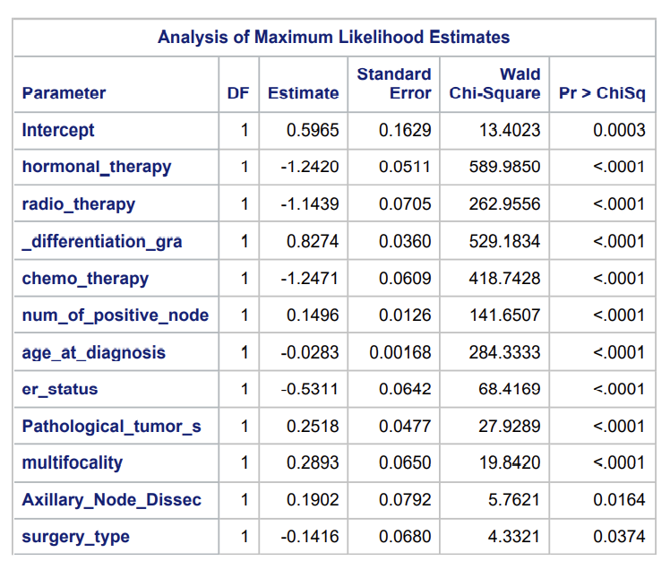
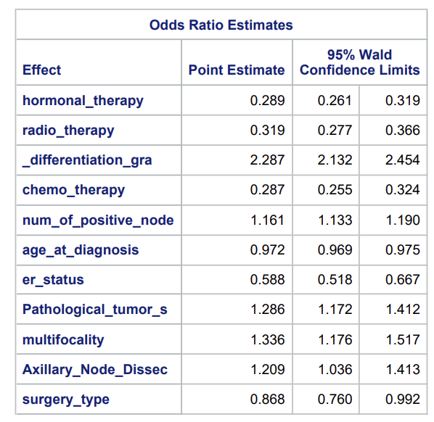
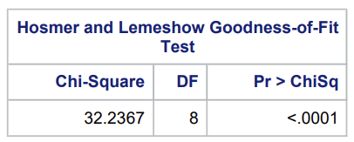
Logistic regression: Model results
Notes:
Pg.222
The intercept's coefficient is 0.5965. It's statistically significant with a p-value of 0.0003, indicating that when all predictors are set to zero, the log-odds of the outcome is significantly different from zero.
Negative coefficients, meaning they are associated with a decrease in the log-odds of the outcome variable, vit_status (alive)
Increase for positive coefficients.
The p-values for all these coefficients are very small (<0.05), indicating that these predictors significantly affect the outcome.
Odds:
Less than 1: It indicates a negative effect of the predictor on being alive. For example, treatments like hormonal therapy and radiotherapy in your study decrease the likelihood of survival.
Greater than 1: It shows a positive effect. This is seen with higher differentiation grades, suggesting these patients have a better chance of survival.
The odds ratio for hormonal_therapy is 0.289, indicating patients receiving hormonal therapy have 0.289 times the odds of being alive compared to those who do not receive this therapy. (71%, a substantial negative effect of hormonal therapy on survival.)
An odds ratio of 2.287 for differentiation grade implies that patients with higher differentiation grades have more than double the odds of being alive compared to those with lower grades. This could be seen as a positive effect, where a higher differentiation grade increases the likelihood of survival.
Hosmer and Lemeshow Test: The Chi-Square value is 32.2367 with a p-value < 0.0001, suggesting that there is a significant lack of fit according to this test. This might indicate that the model does not adequately describe the observed outcomes across different groups of data.

Slide 20
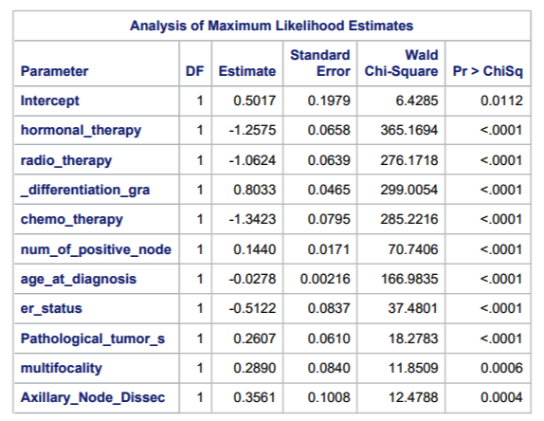
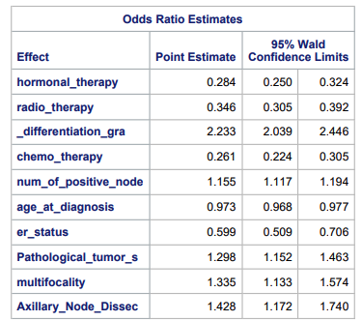
Logistic regression: Data Validation results
Notes:
PG.410-
The model was then validated using a data splitting approach, where the dataset was divided, and the model was trained on one part and tested on another.
The results from the Hosmer and Lemeshow test show a chi-square of 26.7971 with a p-value of 0.0008, indicating a potential lack of fit. This suggests that the model might not predict as accurately across all groups of the validation dataset. (next page)

Slide 21
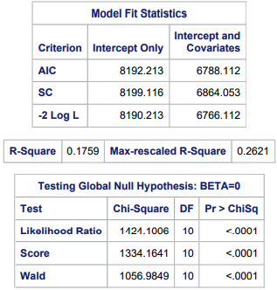
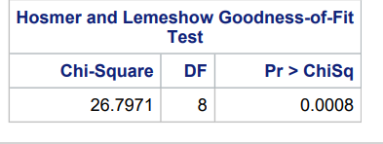
Logistic regression: Assessing Overall Model Fit
According to Log Likelihood criterion the –2LL value of the base model is 8190, while for the final model it is 6766, indicates improvement in the model fit of stepwise regression.
All the model fit statistics for final logistic regression are very high, indicating not a good fit (>6500). Smaller values indicates a better model fit
Hosmer and Lemeshow Goodness-of-fit Test value less than <0.05, indicates that the data does not fit the model well (low p-value indicates the poor fit)

Slide 22
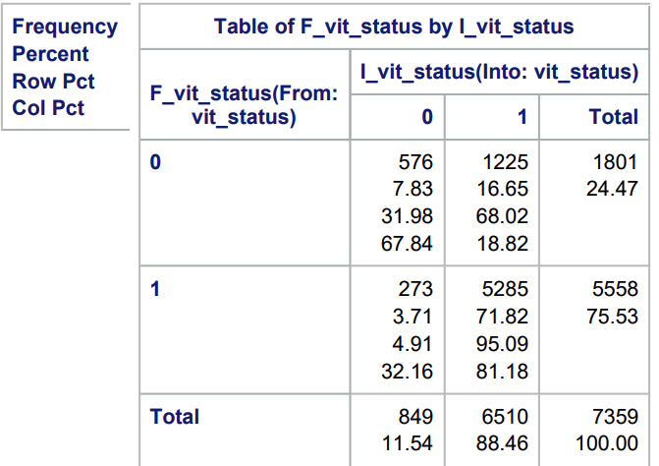
Logistic regression: Original Data Classification Crosstabulation
Predicting alive (1) is pretty good (71.82%), while predicting dead (0) is very low (7.83%)
Percentage of sample correctly predicted is 79.6%. Calculation =[(576+5285)/7359]

Slide 23
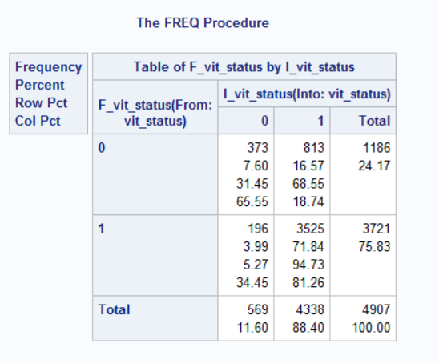
Logistic regression: holdout Data Classification Crosstabulation
Predicting alive (1) is pretty good (71.84%), while predicting dead (0) is very low (7.60%)
Percentage of sample correctly predicted is 79.4% Calculation =[(373+3525)/4907]

Slide 24
Conclusion from the CLASSIFICATION CROSSTABULATION
Model maintains similar performance in identifying the correct class in both the holdout and the original dataset
Overall, logistic model performance is relatively consistent between the two datasets.
 | Predicting Alive(%) | Predicting Dead(%) | Correct Classification(%)
Original Dataset | 71.82 | 7.83 | 79.6
Holdout Dataset | 71.84 | 7.60 | 79.4

Slide 25
Summary & Conclusion
Out data examination shows that our data has a lot of outliers for some of the metric variables, and it also shows that the categorical variables are sometimes very unevenly represented.
The factor analysis shows the metric variables can be reduced to three factors; telling us something about duration information, node information, and tumor size information.
The logistic regression model, created with stepwise regression, shows which variables can significantly predict fatality. However, our accuracy is not too high, leaving room for improvement in the future.

Slide 26

Policy Recommendations
Given the results of the logistic regression, it was determined that hormonal_therapy and radio_therapy had the most significant influence on the variable vit_status.
Variable hormonal_therapy had the highest chi-square score of 286.57, followed by radio_therapy with a chi-square score of 275.00.
Our recommendation is that hormonal therapy, followed by radio therapy, are used before other methods of remediation to improve patient's chances of survival.

Slide 27
Discussion & Recommendations
Dealing with missing and unknown data:
We have deleted all NA and unknown observations to ensure data integrity and consistency.
Despite efforts to clean the data, imperfections will still exist, necessitating cautious interpretation of the results.
There are other various techniques to deal with missing data besides deletion, such as imputation.
The dataset contains numerous outliers, which is logical given the unpredictable nature of cancer cases.
Outliers may skew statistical analyses and should be carefully accounted for in the interpretation of results.
Model Limitations:
Not all assumptions of multivariate logistic regression are met perfectly, contributing to limitations in the accuracy and reliability of our logistic regression model.
While logistic regression offers valuable insights, its predictive capabilities may be hindered by the imperfect nature of the data and underlying assumptions.
Navigating Uncertainty:
Despite these challenges, our analysis provides valuable insights into breast cancer prognosis and treatment outcomes, offering a foundation for further research and clinical decision-making.
Dealing with Outliers:
Outliers were retained in our dataset, to capture the variability inherent in the study.
There are various techniques to deal with outliers, such as deletion or data transformation.
Influential outliers
Skewed dependent variable

